Slide 1
Adjusting and Closing Entries - Accounting Principles
2022. 3.
Dr. Yangin Yoon

Slide 2
Agenda
Recap the last class
Financial Statements
Media Examples
Cash Accounting vs. Accrual Accounting
Accounting Official Terms
Exercise

Slide 3
Recap the last class
Format of Accounting Records rule #1
- Asset (Left)
- Liability (Right)
- Equity (Right)
Income Statement
Balance sheet

Slide 4
Recap the last class
Format of Accounting Records rule #1
- Asset (Left)
- Liability (Right)
- Equity (Right)
Expense (loss)
Gain (Revenue)

Slide 5
Asset Liability
Equity
Let’s make our own simple examples!
Example #2) Borrowing a money
It was established with $5,000 of cash, and AP Bakery borrowed $800 from a bank. There is no other transactions. ( We assume there is no time value of money.)
In the above example, “Cash” is asset and “Bank Loan” is liability.
Cash $5,000
Capital Stock $5,000
Cash $800
Bank Loan $800

Slide 6
Asset Liability
Equity
Example #2)
It was established with $5,000 of cash, and AP Bakery borrowed $800 from a bank. There is no other transactions. ( We assume there is no time value of money.)
→ Balance Sheet of AP Bakery
Cash $5,000
Capital Stock $5,000
Cash $800
Bank Loan $800
ASSETS |  |  | LIABILITIES AND EQUITY
 |  |  | LIABILITIES
Cash | $5,800 | $30,920 | Bank Loan | $800
 |  | $1,000 | TOTAL LIABILITIES | $800
 |  | $31,920
 |  |  | EQUITY
 |  |  | Capital Stock | $5,000
 |  |  | TOTAL EQUITY | $5,000
TOTAL ASSETS $5,800 |  |  | TOTAL LIABILITIES and EQUITY $5,800

Slide 7
Asset Liability
Equity
Example #4) Renting a shop with deposit
It was established with $5,000 of cash, and AP Bakery bought new chairs by paying $200.
And AP Bakery rented a shop by giving $1,000 deposit.
In the above example, “Cash” is asset and “Deposit” is also asset.
→ Increasing asset is on the left side.
Decreasing assets is on the right side.
Cash $5,000
Capital Stock $5,000
Chair $200
Cash $200
Deposit $1,000
Cash $1,000

Slide 8
Asset Liability
Equity
Expense Revenue
Example #7) Providing Consulting service
ST Consulting was established with $20,000. There were following events.
 | Mar. 1st~Mar.30th
Consulting Revenue (Cash) | $1,000
Electricity Expense (Cash) | $700
Cash $20,000
Capital Stock $20,000
Cash $1,000
Revenue (gain) $1,000
Electricity Expense $700
Cash $700

Slide 9
Asset Liability
Equity
More examples)
The company buys land by paying $10,000 of cash.
The company borrows money ($5,000) from a bank.
The company pays interest expense by paying $150 of cash.
The company repays the whole bank loan.
Land $10,000
Cash $10,000
Cash $5,000
Bank Loan $5,000
Interest Expense $150
Cash $150
Bank Loan $5,000
Cash $5,000

Slide 10
Homework #1
The homework will be posted on E-class
Due date is March 21, 09:59 AM
Example
Let’s assume that you are the head of accounting department of ABC Inc. The following are transactions of ABC Inc. Please make general entries on each transaction.
(Tr#1)
ABC Inc. issued stocks. The capital stock was increased by $1,000. The company received $1,000 of cash for this.

Slide 11
Any Questions? (Recap)

Slide 12
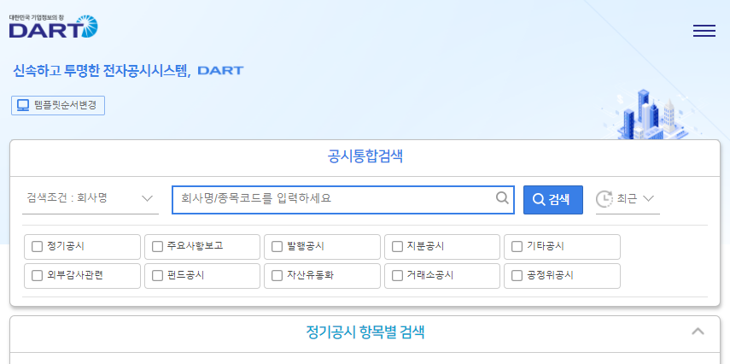
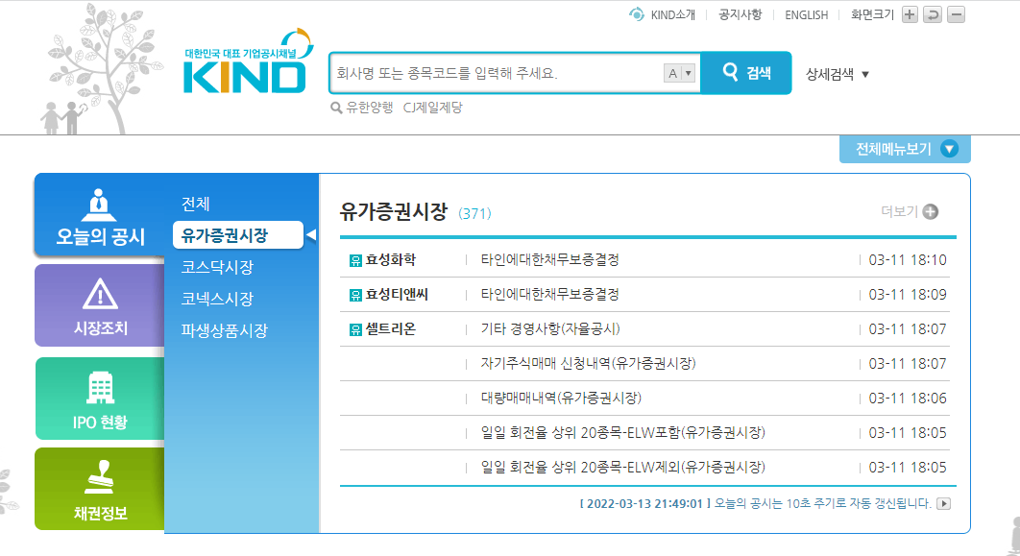
Financial Statements
Korean Companies:
https://dart.fss.or.kr/
https://kind.krx.co.kr/

Slide 13
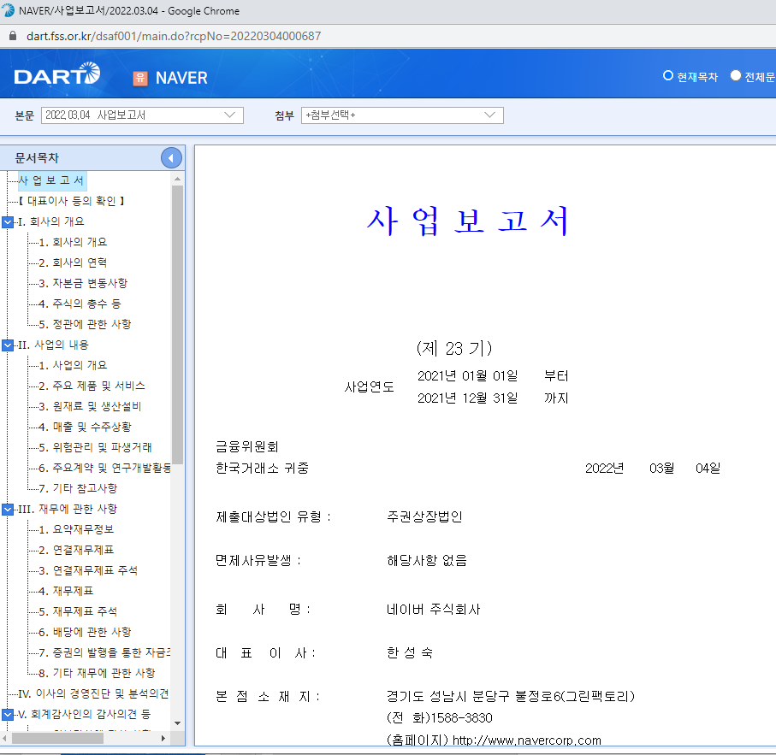
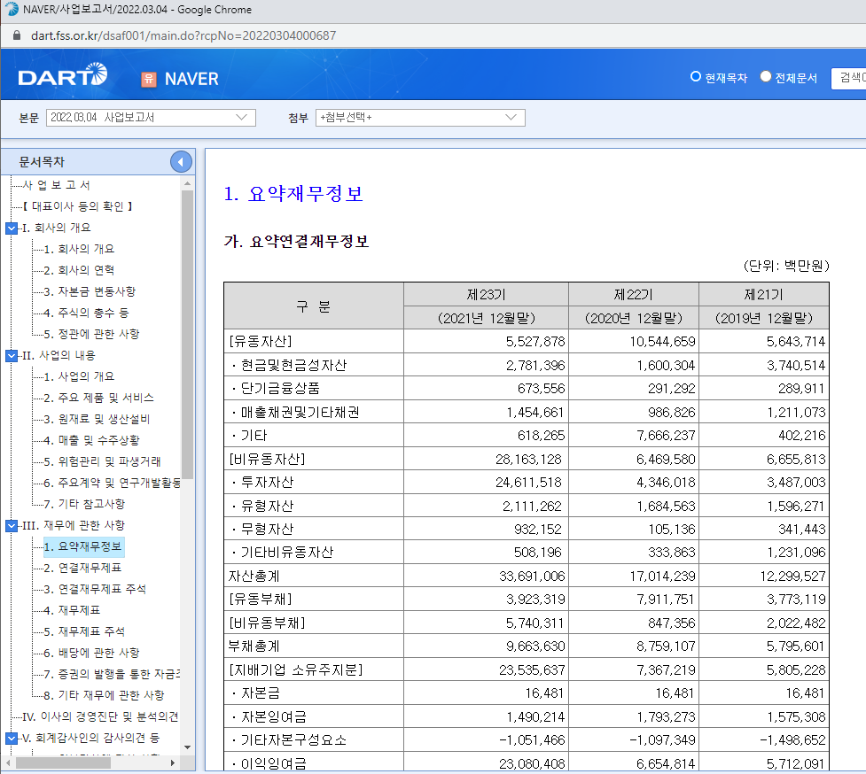
Financial Statements
Korean Companies:
- Samsung Electronics (삼성전자)
- NAVER

Slide 14
Media Examples
News articles
http://www.newsfreezone.co.kr/news/articleView.html?idxno=363042
https://www.mk.co.kr/star/musics/view/2022/02/184456/
https://m.mk.co.kr/news/stock/view/2022/02/143443/
https://news.mt.co.kr/mtview.php?no=2019032514074829210
https://www.etoday.co.kr/news/view/2069777
https://news.einfomax.co.kr/news/articleView.html?idxno=4082054
e.g.) Tangible Assets, Marketing expense, Interest expense, etc.

Slide 15
Any Questions?

Slide 16
Consulting Company Case
Setting
- Jane, Sam, and Tom and studied Data-mining at the same university.
- Three of them decided to open a big data consulting firm.
- They invested their own money:
Jane ($12,000), Sam ($6,000), Tom ($2,000)
- They made a corporation for their consulting business. (The name of the corporation is “ST Consulting”)
- They ran their business from November to December
(multiple periods).

Slide 17
Asset Liability
Equity
Example #9) Providing Consulting service – on-credit revenue
ST Consulting was established with $20,000, and $9,000 bank loan. There were following events.
→ Excel file for details
 | Nov. 1st~Nov.30th | Dec. 1st ~ Dec. 31st | Jan. 1st ~ Jan. 31st
Consulting Revenue (Cash) | $1,000 | $5,000 | $6,000
Consulting Revenue (on credit, pay later) | $0 | $1,000 | $2,000
Salary Expense (Cash) | $2,000 | $2,000 | $2,000
Interest Expense (Cash) | $40 | $40 | $40

Slide 18
Cash Accounting vs. Accrual Accounting
ST Consulting borrowed $10,000 with 5% annual interest rate from a Bank on Oct. 1st, 2021.
- The borrowing period is one year.
- The principal ($10,000) and its interest ($500) will be paid on Sep. 30th, 2022 by cash.
What is the interest expense during the year 2021?
Option #1) Zero
Option #2) $500 * 3 / 12 = $125
Option #3) $500

Slide 19
Cash Accounting vs. Accrual Accounting
ST Consulting borrowed $10,000 with 5% annual interest rate from a Bank on Oct. 1st, 2021.
- The borrowing period is one year.
- The principal ($10,000) and its interest ($500) will be paid on Sep. 30th, 2022 by cash.
How should ST consulting make its accounting record for its interest expense?
Dec.31., 2021
Interest Expense $125
Unpaid Interest Expense $125

Slide 20
Cash Accounting vs. Accrual Accounting
ST Consulting rented a shop with $10,000 of deposit and $500 of monthly fee for two years from Dec. 1st, 2021 to Nov. 30th , 2023.
- ST Consulting paid $10,000 of cash as deposit on Dec. 1st, 2021.
- And ST Consulting also paid $1,500 of cash for its three-month rent fee in advance as cash on Dec. 1st, 2021.
Accounting Records on Dec. 1st, 2021?
Dec.1., 2021
Deposit $10,000
Cash $10,000
Dec.1., 2021
Pre-paid Rent Fee $1,500
Cash $1,500

Slide 21
Cash Accounting vs. Accrual Accounting
ST Consulting rented a shop with $10,000 of deposit and $500 of monthly fee for two years from Dec. 1st, 2021 to Nov. 30th , 2023.
- ST Consulting paid $10,000 of cash as deposit on Dec. 1st, 2021.
- And ST Consulting also paid $1,500 of cash for its three-month rent fee in advance as cash on Dec. 1st, 2021.
Accounting Records on Dec. 1st, 2021?
Accounting Records on Dec. 31st, 2021?
Dec.1., 2021
Deposit $10,000
Cash $10,000
Dec.1., 2021
Pre-paid Rent Fee $1,500
Cash $1,500
Dec.31., 2021
Rent Expense $500
Pre-paid Rent Fee $500

Slide 22
Accounting Official Terms
Journal Entry (General Journal Entry)
- Left Item: Credit
- Right Item: Debit
Example of Journal Entry
(Cr) Cash $2,000
(Dr) Bank Loan $2,000

Slide 23
Accounting Official Terms
Trial Balance
- Aggregated all journal entries
Adjusting Entries
- Reflecting accrual accounting
- Examples:
Dec.31., 2021
Interest Expense $125
Unpaid Interest Expense $125
Dec.31., 2021
Rent Expense $500
Pre-paid Rent Fee $500

Slide 24
Accounting Official Terms
Types of Adjusting Entries
1) Unrecorded receivables
2) Unrecorded liabilities
3) Prepaid expenses
4) Unearned revenues

Slide 25
Accounting Official Terms
Trial Balance
Adjusted Trial Balance
- Trial Balance + Adjusting Entries
Closing Entries
- Moving revenue accounts and expense accounts into one equity account
- After closing entries, there will be zero balance amounts in revenue and expense accounts
- Example:
Revenue (gain) $5,000
Salary Expense $2,000
Earnings $3,000

Slide 26
Accounting Official Terms
After adding adjusting entries and closing entries, we can get balance sheet.
Revisit the previous MS-Excel example

Slide 27
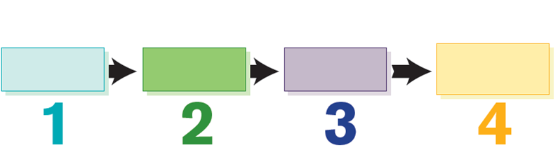
Accounting Cycle
LO5
Record the effects of
transactions.
1 Posting journal entries.
Analyze transactions.
1
2
Step
Step
Summarize the effects of
transactions.
1 Preparing a trial balance.
Prepare reports.
1 Adjusting entries.
2 Preparing financial statements.
3 Closing the books.
3
4
Step
Step

Slide 28
Any Questions?

Slide 29
Exercise
Record the following transactions in journal entry form.
a. Provided services for $3,200 on account.
b. Borrowed $32,000 from a bank.
c. Issued stock for $7,200.
d. Purchased equipment costing $120,000; with cash of $32,000 and a note for the remainder.
e. Paid off the loan of $32,000 plus $400 interest.

Slide 30
Exercise
Record the following transactions in journal entry form.
a. Accounts Receivable 3,200
Services Revenue 3,200
b. Cash 32,000
Notes Payable (or Bank Loan) 32,000
c. Cash 7,200
Capital Stock 7,200
d. Equipment 120,000
Cash 32,000
Notes Payable 88,000
e. Notes Payable (or Bank Loan) 32,000
Interest Expense 400
Cash 32,400

Slide 31
Exercise
Telecon, Inc. was established a few years ago. Telecon, Inc., experienced the following transactions during May 2017. Prepare the appropriate journal entries to record these transactions.
May 8 Paid monthly rent of $4,000.
11 Purchased equipment for $160,000, paying 40% in cash and signing a note for the balance.
15 Provided services costing $15,000 for $25,000 cash.
21 Purchased a 2-year insurance policy for $10,000.
25 Paid $8,000 on account.
28 Collected $5,000 in accounts receivable.
29 Sold an additional 500 shares of capital stock for $20,000.
30 Paid utilities of $3,000.

Slide 32
Exercise
Telecon, Inc. was established a few years ago. Telecon, Inc., experienced the following transactions during May 2017. Prepare the appropriate journal entries to record these transactions.
May 8 Rent Expense 4,000
Cash 4,000
11 Equipment 160,000
Cash 64,000
Notes Payable 96,000
15 Cash 25,000
Sales Revenue 25,000
Cost of Goods Sold 15,000
Inventory 15,000
21 Prepaid Insurance 10,000
Cash 10,000

Slide 33
Exercise
Telecon, Inc. was established a few years ago. Telecon, Inc., experienced the following transactions during May 2017. Prepare the appropriate journal entries to record these transactions.
May 25 Accounts Payable 8,000
Cash 8,000
28 Cash 5,000
Accounts Receivable 5,000
29 Cash 20,000
Capital Stock 20,000
30 Utilities Expense 3,000
Cash 3,000

Slide 34
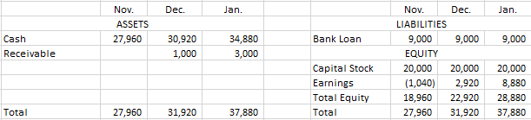
Asset Liability
Equity
Example ) Providing Consulting service – on-credit revenue
ST Consulting was established with $20,000, and $9,000 bank loan. There were following events.
Balance Sheet at the end of three months
 | Nov. 1st~Nov.30th | Dec. 1st ~ Dec. 31st | Jan. 1st ~ Jan. 31st
Consulting Revenue (Cash) | $1,000 | $5,000 | $6,000
Consulting Revenue (on credit, pay later) | $0 | $1,000 | $2,000
Salary Expense (Cash) | $2,000 | $2,000 | $2,000
Interest Expense (Cash) | $40 | $40 | $40

Slide 35
Any Questions?

